Slide 1
EDW Data Quality Overview

Slide 2
Reasons
Netezza limitations
No referential integrity in Netezza
Lack of unique constraints / indexes
No visibility over data quality currently
CIL exposes common data to other applications either through STOVs or Common DMs – so it’s especially important to have good data at the start of pipline and not replicate issues downstream
Some data areas are subject of business anxiety due to data quality, which undermine trust in EDW
No automatic way to validate quality of handed over source to CIL; without autometed method process will be very time-consuming and inefficient

Slide 3
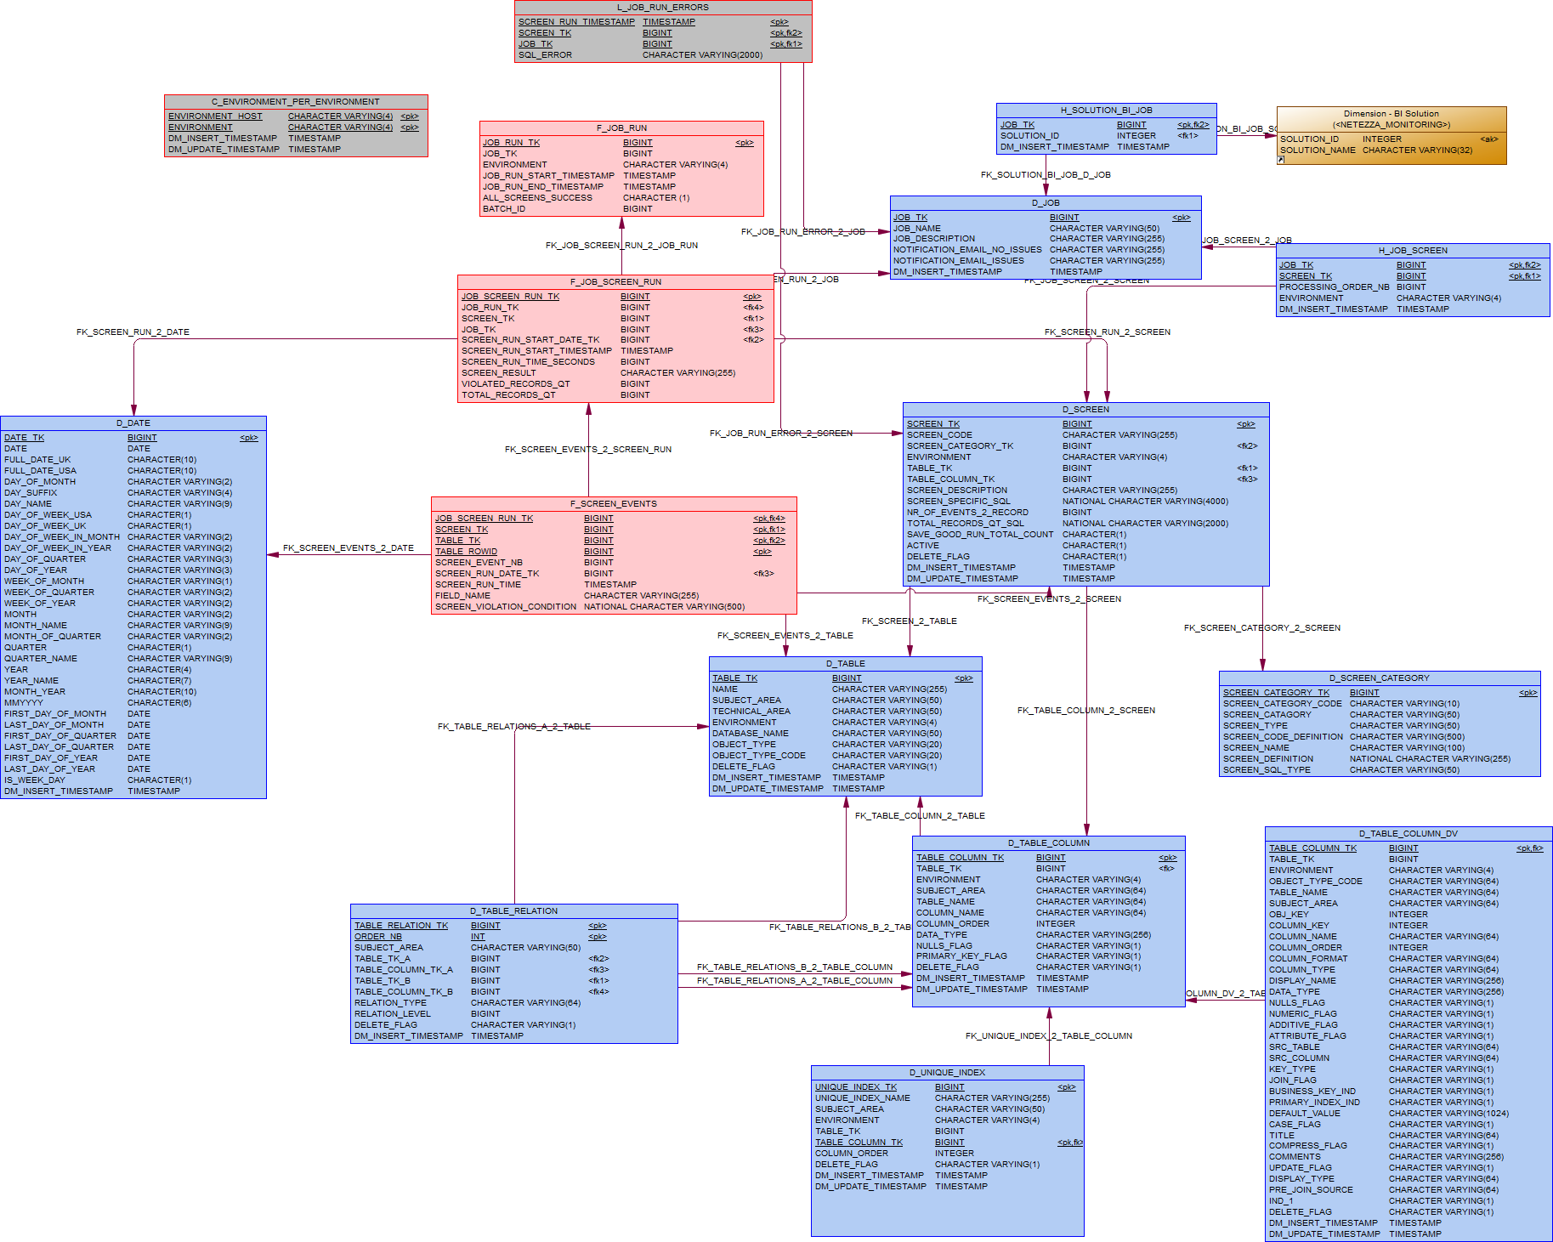
Diagram

Slide 4
Tables
TABLENAME | DESCRIPTION
D_DATE | Generic date dimension
D_TABLE | Dimension listing EDW tables; There needs to be one 'N/A' record added for screens not applicable on table / view level.
D_TABLE_COLUMN_DV | Table storing Wherescape Metadata
F_TABLE_RELATIONS | Table storing relations between tables, like Table A is a source for Table B
D_SCREEN_CATEGORY | Configuration table storing screen categories, types and generic definition.
D_SCREEN | Configuration table storing screen definition.
D_JOB | Configuration table, storing job specifc parameters, description , meaningful code, notification email etc. It's needed to server as for grouping of screens that need to be executed within one job
H_JOB_SCREEN | Configuration table storing screens that should be performed within one execution of the job.
H_SOLUTION_BI_JOB | Table linking JOBs with BI Solution from MONITORING_DM.BI_SOLUTIONS
F_JOB_SCREEN_RUN | Each row in this table correspondes to a screen run, giving details such as screen run result and total number of error records.
F_SCREEN_EVENTS | Each data-quality vialation within a single screen is captured as a row in the event fact table. One screen can return as many records as there a table records for table / column screens. Sometimes one error is reflected by 2, 3 or more records for complex structure or business rule screen, where a single event generates many rows in this error event fact table. Thus, SCREEN_EVENT# helps to group records accountable for one screen event. Most of the time however it will be one record per registered error, for example one record for each NULL record in specific column.
L_JOB_RUN_ERRORS | Log table informing about failed screen runs from within job execution;

Slide 5
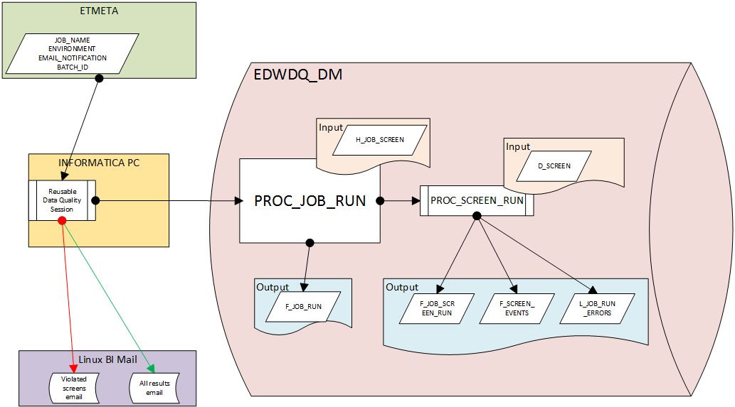
Solution

Slide 6
Results – stats
SCREEN_NAME | NAME | SCREEN_DESCRIPTION | SCREEN RESULT | VIOLATED RECORDS_QT
Unique combination of columns | SAT_GLOPPS_DCN_ACCOUNT_CON | Unique columns: DV_VERSION, HUB_DCN_ACCOUNT_CON_SID | Violated | 2
DV_CURRENT_FLAG correct values | SAT_GLOPPS_DCN_ACCOUNT_CON | DV_CURRENT_FLAG correct values screen for: SAT_GLOPPS_DCN_ACCOUNT_CON | Violated | 2
Unique combination of columns | SAT_GLOPPS_PARTSUPPLIERCROSS | Unique columns: DV_VERSION, HUB_PARTSUPPLIERCROSS_SID | Violated | 17958297
DV_CURRENT_FLAG correct values | SAT_GLOPPS_PARTSUPPLIERCROSS | DV_CURRENT_FLAG correct values screen for: SAT_GLOPPS_PARTSUPPLIERCROSS | Violated | 17958389
Unique combination of columns | SAT_GLOPPS_PART_JOB_QUEUE | Unique columns: DV_VERSION, HUB_PART_JOB_QUEUE_SID | Violated | 22992279
DV_CURRENT_FLAG correct values | SAT_GLOPPS_PART_JOB_QUEUE | DV_CURRENT_FLAG correct values screen for: SAT_GLOPPS_PART_JOB_QUEUE | Violated | 22419215
Unique combination of columns | SAT_GLOPPS_STRUCTURE_ROW | Unique columns: DV_VERSION, HUB_STRUCTURE_ROW_SID | Violated | 6282894
DV_CURRENT_FLAG correct values | SAT_GLOPPS_STRUCTURE_ROW | DV_CURRENT_FLAG correct values screen for: SAT_GLOPPS_STRUCTURE_ROW | Violated | 6436916
Unique combination of columns | SAT_GLOPPS_STRUCTURE_VERSION_INFO | Unique columns: DV_VERSION, HUB_STRUCTURE_VERSION_INFO_SID | Violated | 6450
DV_CURRENT_FLAG correct values | SAT_GLOPPS_STRUCTURE_VERSION_INFO | DV_CURRENT_FLAG correct values screen for: SAT_GLOPPS_STRUCTURE_VERSION_INFO | Violated | 6818

Slide 7
Results – queries
/***SAT_GLOPPS_DCN_ACCOUNT_CON: DV_CURRENT_FLAG correct values screen for: SAT_GLOPPS_DCN_ACCOUNT_CON***/
/* Example: 1*/
SELECT * FROM PROD_EDW_DATAVAULT..SAT_GLOPPS_DCN_ACCOUNT_CON A WHERE ROWID IN (3904981639303080204
, 3904981639303080224) ORDER BY A.ROWID ;
/***SAT_GLOPPS_DCN_ACCOUNT_CON: Unique columns: DV_VERSION, HUB_DCN_ACCOUNT_CON_SID***/
/* Example: 1*/
SELECT * FROM PROD_EDW_DATAVAULT..SAT_GLOPPS_DCN_ACCOUNT_CON A WHERE ROWID IN (3904981639303080204
, 3904981639303080224) ORDER BY A.ROWID ;
/***SAT_GLOPPS_PARTSUPPLIERCROSS: DV_CURRENT_FLAG correct values screen for: SAT_GLOPPS_PARTSUPPLIERCROSS***/
/* Example: 1*/
SELECT * FROM PROD_EDW_DATAVAULT..SAT_GLOPPS_PARTSUPPLIERCROSS A WHERE ROWID IN (3904981639354040641)
/***SAT_GLOPPS_PARTSUPPLIERCROSS: Unique columns: DV_VERSION, HUB_PARTSUPPLIERCROSS_SID***/
/* Example: 1*/
SELECT * FROM PROD_EDW_DATAVAULT..SAT_GLOPPS_PARTSUPPLIERCROSS A WHERE ROWID IN (3904981639354040641
, 3904981639354063293) ORDER BY A.ROWID ;
/* Example: 2*/
SELECT * FROM PROD_EDW_DATAVAULT..SAT_GLOPPS_PARTSUPPLIERCROSS A WHERE ROWID IN (3904981700793023721
, 3904981700793023722) ORDER BY A.ROWID ;
/* Example: 3*/
SELECT * FROM PROD_EDW_DATAVAULT..SAT_GLOPPS_PARTSUPPLIERCROSS A WHERE ROWID IN (3904981736554898247
, 3904981736554898248) ORDER BY A.ROWID ;

Slide 8
Data Quality Benefits
Visibility into over EDW data quatlity
Generic framework for other teams to implement more tests
Corrective actions can be taken based on the results
Increasing business trust in EDW
Continues screening of data and hence quicker response time to the issues
Trends of data quaility over time
Better data integration through consistent business key defitnitinos acros application sources
ETL recommendations to DRS and rest of the BI teams that would prevent data quality issues
Automatic screens of to be handed over sources

